Slide 1
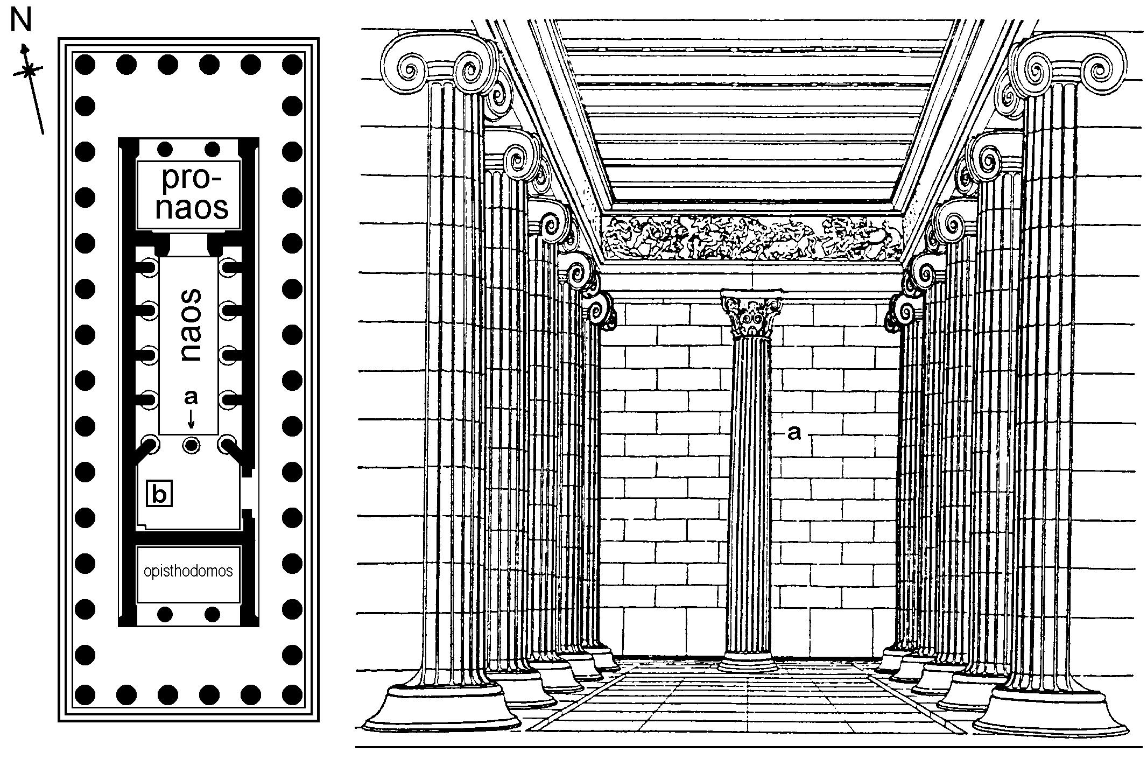
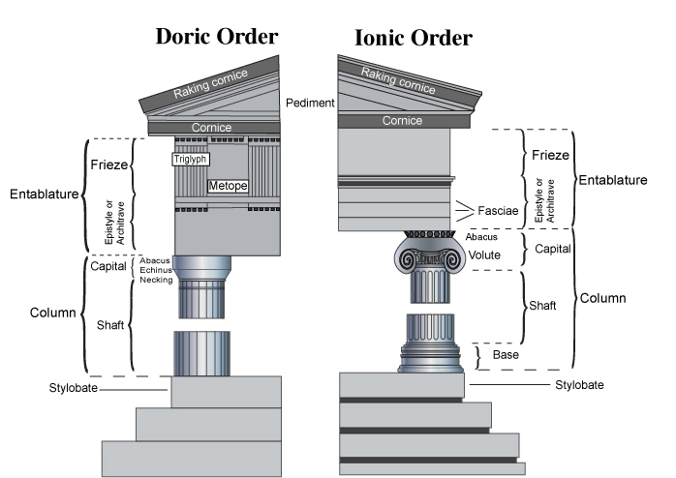
Greek Temple

Slide 2
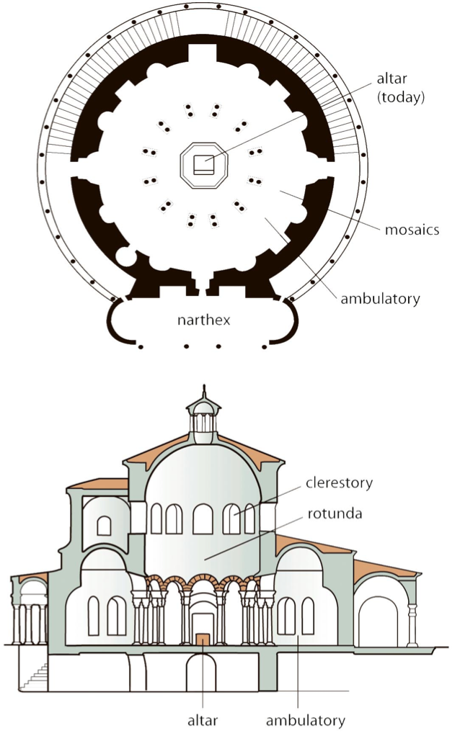
Early Christian

Slide 3
Early Christian

Slide 4
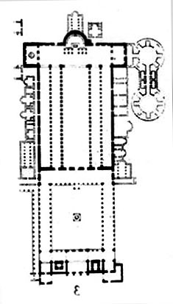
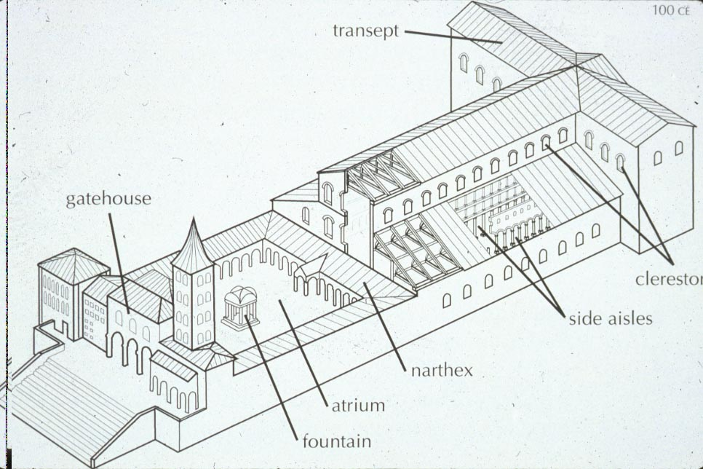
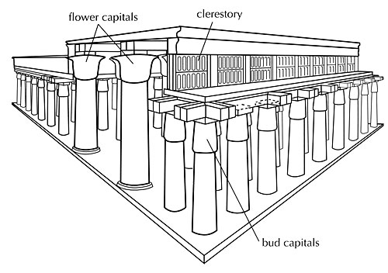
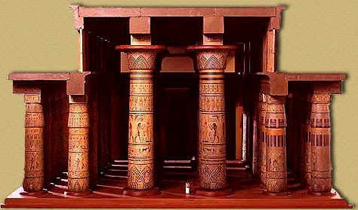
Early Christian

Slide 5
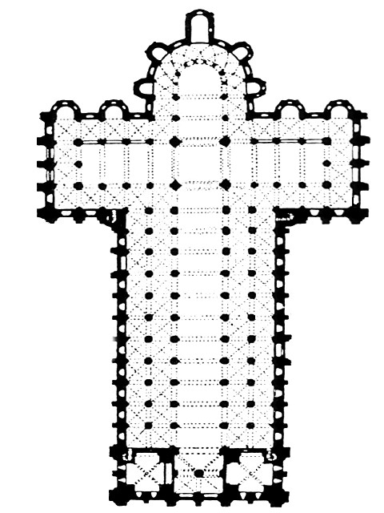
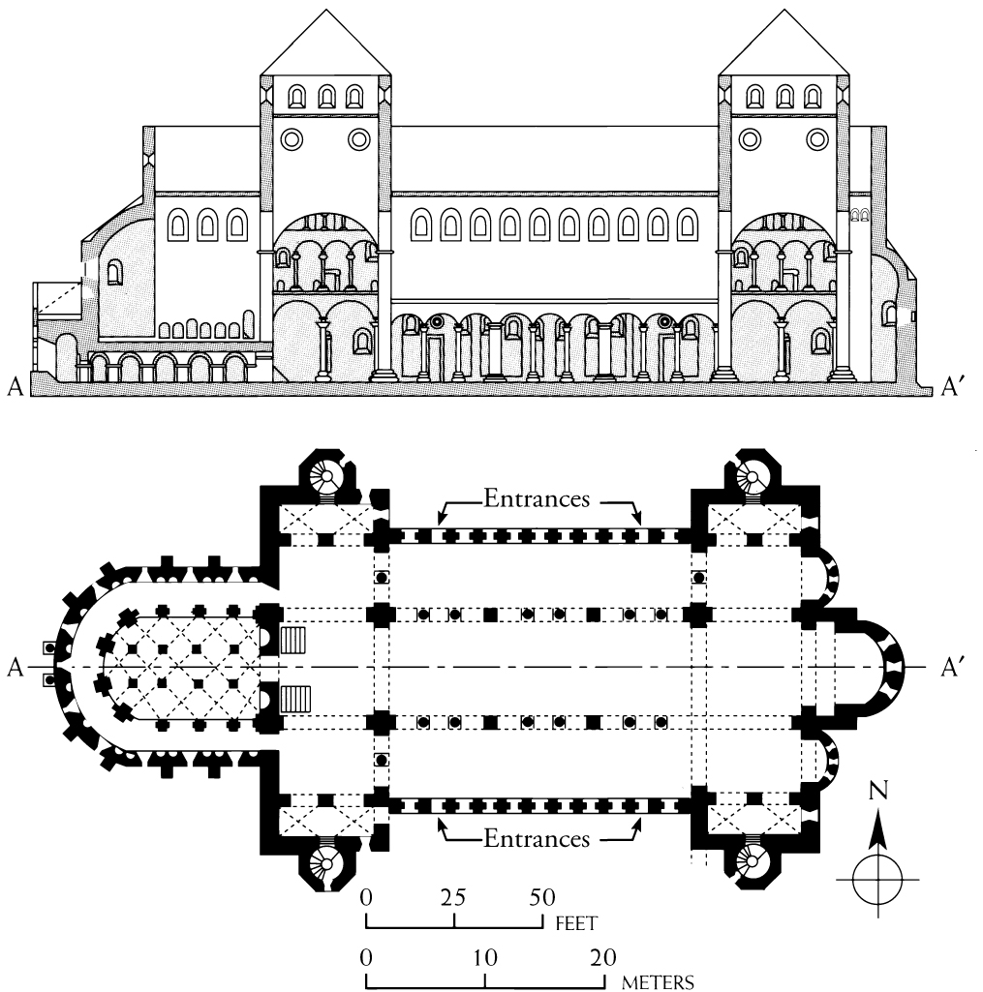
St Michael’s St Sernin

Slide 6
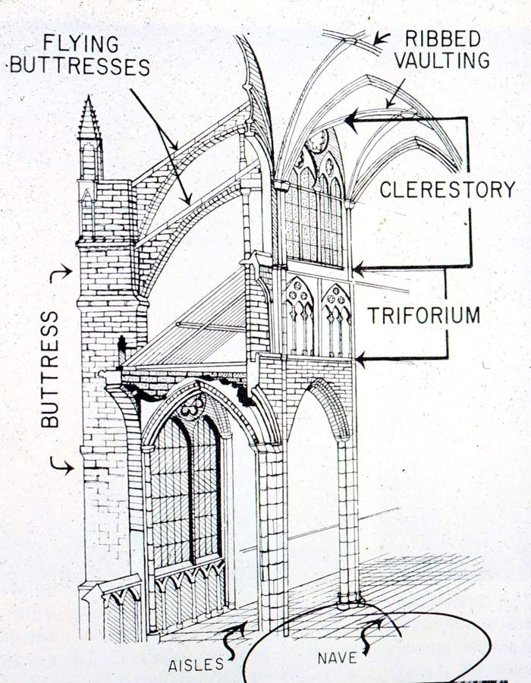
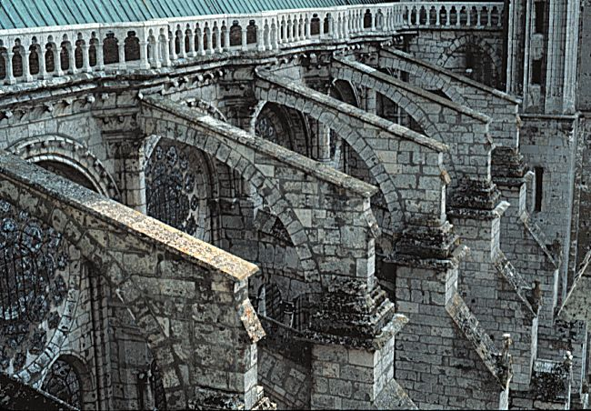
High Gothic Flying Buttress

Slide 7
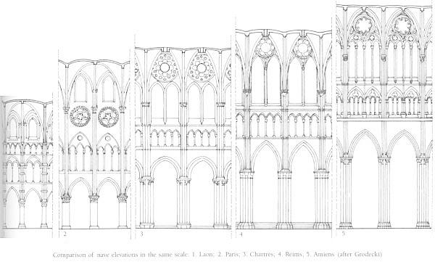

Slide 8
Bramante Michelangelo St. Peter’s

Slide 9
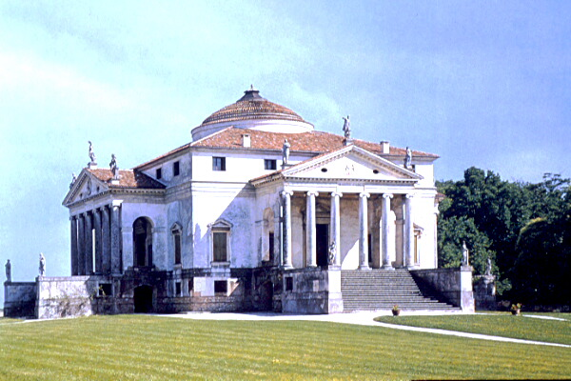
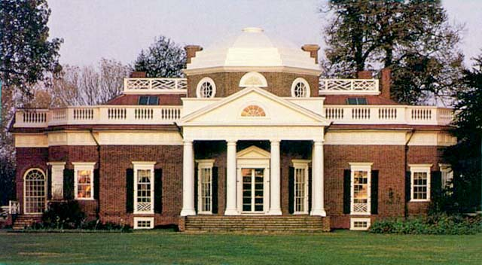
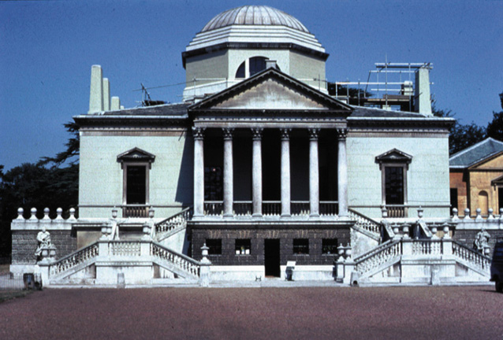
HR Villa Rotunda NC Chiswick Hs NC Monticello Palladio Kent/ Boyle Jefferson

Slide 10
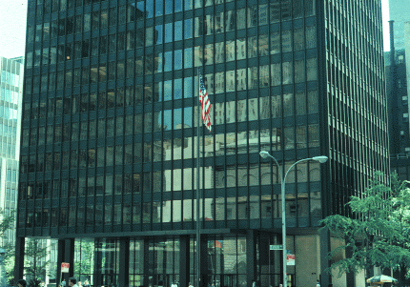
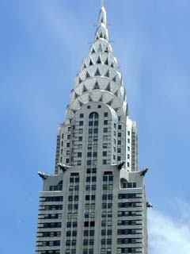
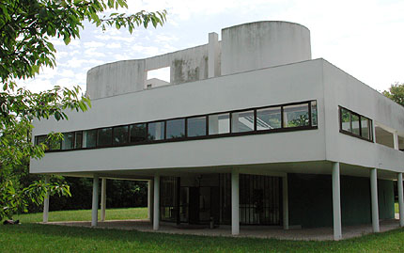
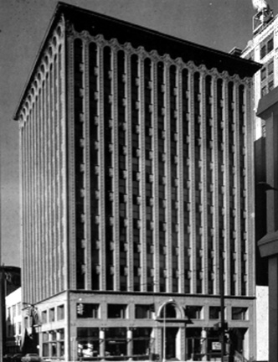
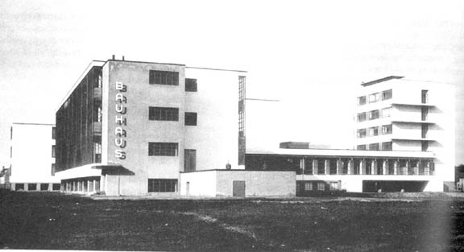
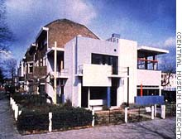
Modern Architecture
Interntl-Le Corbusier Villa Savoye, Dame du Haut, machine for living
Mod-Mies van der Rohe, Philip Johnson, Seagrams Building, glass
Art Deco-William van Allen Chrysler Building
Louis Sullivan, Prudential
Bauhaus, Gropius
De Stijl-Rietveld, Schroder House

Slide 11
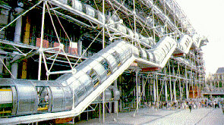
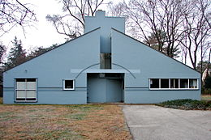
Renzo Paino, Richard Rogers
Pompadeau Art Center
Robert Venturi
Robert Venturi

